Slide 1

Software Quality Engineering
Dr. Sumaira Nazir
Assistant Professor
Department of Software Engineering
National University of Modern Languages, Islamabad

Slide 2
Agenda
Software Testing Classifications/Types

Slide 3
Software Test Classifications
There are two accepted classification schemes:
Black Box testing
While Box testing.

Slide 4
Software Test Classifications
Black box testing – IEEE definition
Testing that ignores the internal mechanism of the system or component and focuses solely on outputs in response to selected inputs and execution conditions.
Testing conducted to evaluate the compliance of a system or component with specified functional requirements.

Slide 5
Black box Equivalence Partitioning
Example: Age Validation System
The system accepts ages between 18 and 60
Input Partitions:
Partition Type | Range | Example Test Case
Valid | 18 to 60 | 30
Invalid | Less than 18 | 10
Invalid | Greater than 60 | 65

Slide 6
Black box Equivalence Partitioning
Test Cases for EP:
Test Input | Expected Output
30 | Eligible
10 | Not Eligible
65 | Not Eligible

Slide 7
Black box Equivalence Partitioning
Test Cases:
Test Case ID | Test Input (Age) | Partition Type | Expected Result
TC_EP_01 | 25 | Valid | Eligible
TC_EP_02 | 10 | Invalid | Not Eligible
TC_EP_03 | 65 | Invalid | Not Eligible

Slide 8
Boundary Value Analysis (BVA)
Boundary Value Analysis (BVA)
Boundary Value Analysis tests values at the edges of valid ranges, as well as just below and above those boundaries.

Slide 9
Boundary Value Analysis
Age System
Valid Input Range:
18 to 60
Boundary Values:
Test Type | Value | Expected Output
Minimum − 1 | 17 | Not Eligible
Minimum | 18 | Eligible
Minimum + 1 | 19 | Eligible
Maximum − 1 | 59 | Eligible
Maximum | 60 | Eligible
Maximum + 1 | 61 | Not Eligible

Slide 10
Boundary Value Analysis
Test Cases:
Test Case ID | Test Input (Age) | Expected Result
TC_BVA_01 | 17 | Not Eligible
TC_BVA_02 | 18 | Eligible
TC_BVA_03 | 19 | Eligible
TC_BVA_04 | 59 | Eligible
TC_BVA_05 | 60 | Eligible
TC_BVA_06 | 61 | Not Eligible

Slide 11
Examples
Example 1: Password Length Validation
A password must be between 8 and 16 characters

Slide 12
Equivalence Partitioning
Partition Type | Input Length | Test Input | Expected Output
Invalid | > 16 | "verylongpassword123" | Rejected
Invalid | < 8 | "short" | Rejected
Valid | 8–16 | "mypassword" | Accepted

Slide 13
Boundary Value Analysis (BVA):
Test Case ID | Input Length | Test Input | Expected Output
TC1 | 7 | "1234567" | Rejected
TC2 | 8 | "12345678" | Accepted
TC3 | 9 | "123456789" | Accepted
TC4 | 15 | "abcdefghijklmno" | Accepted
TC5 | 16 | "abcdefghijklmnop" | Accepted
TC6 | 17 | "abcdefghijklmnopq" | Rejected

Slide 14
Software Test Classifications
White box testing – IEEE definition
Testing that takes into account the internal mechanism of a system or component.

Slide 15
Black-box Testing
Focus: I/O behavior. If for any given input, we can predict the output, then the module passes the test.
Almost always impossible to generate all possible inputs ("test cases").

Slide 16
Black-box Testing
Goal: Reduce number of test cases by equivalence partitioning:
Divide input conditions into equivalence classes.
Choose test cases for each equivalence class.
Example: If an object is supposed to accept a negative number, testing one negative number is enough.

Slide 17

White-box Testing
Focus: Thoroughness (Coverage). Every statement in the component is executed at least once.
Four types of white-box testing
Statement Testing
Loop Testing
Path Testing
Branch Testing

Slide 18
White-box Testing…
Statement Testing (Algebraic Testing): Test single statements
Loop Testing:
Cause execution of the loop to be skipped completely. (Exception: Repeat loops)
Loop to be executed exactly once
Loop to be executed more than once
Path testing:
Make sure all paths in the program are executed
Branch Testing (Conditional Testing): Make sure that each possible outcome from a condition is tested at least once.
if ( i =
TRUE) printf("YES\n");
else
printf("NO\n");
Test cases: 1) i = TRUE; 2) i = FALSE

Slide 19
White-box Testing- Loop Testing
Simple
loop
Nested
Loops
Concatenated
Loops

Slide 20
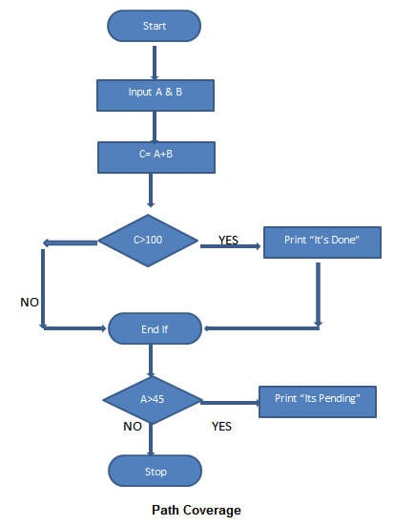
White-box Testing: Example
INPUT A & B
C = A + B
IF C>100
PRINT “ITS DONE”
END IF
IF A>50
PRINT “ITS PENDING”
END IF

Slide 21
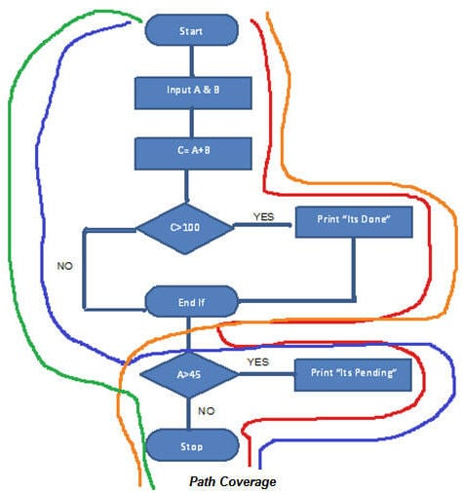
White-box Testing: Example
Red Line TestCase_01: A=50, B=60
Blue Line TestCase_02: A=55, B=40
Orange Line TestCase_03: A=40, B=65
Green Line TestCase_04: A=30, B=30

